Slide 1
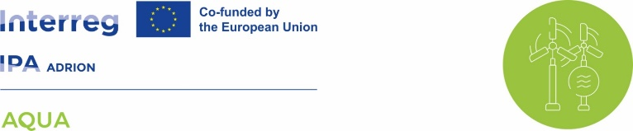
AQUA: Europe united to strengthen water resilience against the climate crisis
ENHANCING WATER MANAGEMENT FOR CLIMATE CHANGE RESILIENCE IN ADRIATIC-IONIAN AREA
The project, based on digital twins, leverages pilot experiences in Italy, Slovenia, Greece, Albania and Serbia to strengthen the resilience of water systems against drought and extreme events.
AQUA project progress
Bari, XX August 2025 – The international AQUA project, aimed at improving the resilience of water systems through the development and enhancement of an integrated suite of tools (monitoring, modeling, decision support), which form the backbone of what are now commonly referred to as digital twins. In the face of increasingly pressing climate change challenges, the project continues its path within a mixed partnership that brings together water and environmental utilities with research institutions and local government bodies from Italy, Slovenia, Greece, Albania and Serbia. The goal of AQUA, co-financed by the European Union through the Interreg IPA ADRION 2021–2027 Programme, is to develop advanced digital tools and a shared roadmap over two years for increasingly sustainable water resource management. In this framework, the heart of the project is then expected to address specific needs across different pilot areas. The added value of the AQUA Project is to optimize and strengthen the links between these components (needs and digital tools) including for instance: monitoring to initialize modeling; leveraging IoT-based sensors to support local and regional decision-makers based on scenario narratives. The project will help each partners to build specific components to implement a future application of a digital twin—true “virtual replicas” of water systems—platforms capable of merging real-world data (hydrological, climatic and environmental) with predictive models. These tools can monitor water flows and provide dynamic simulations, supporting more effective and timely strategic decisions. A true revolution that transforms water management from reactive to predictive.
Project budget in EUR
1.671.999,60
INTERREG funding in EUR
1.421.199,65
Project duration
36 months
In the first months of work, project partners developed an integrated approach combining top-down contributions (institutions, policies, European best practices) with bottom-up inputs (local challenges analysis and community engagement). The main activities carried out included a desk review of the best European experiences on digital twins, with a special focus on the countries directly involved in the project. In parallel, a review of scientific articles and international projects was conducted to outline the state of the art of digital technologies applied to water management These activities were complemented by the collection of needs and criticalities identified in the national pilot sites. The joint work of the partners also led to the drafting of a transnational action plan, which represents the first shared roadmap for resilient water management in the ADRION area.
In the next phases, the project will support each partners to develop specific tools based on the specific issues encountered, within the Pilot area identified where the digital twin framework could work well.
At the same time, meetings with local stakeholders will continue to ensure that the solutions adopted are in line with community needs and shared with the competent authorities.
https://aqua.interreg-ipa-adrion.eu/

Slide 2
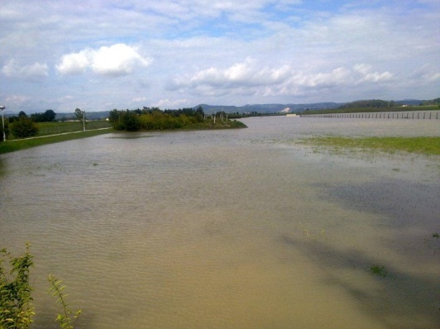
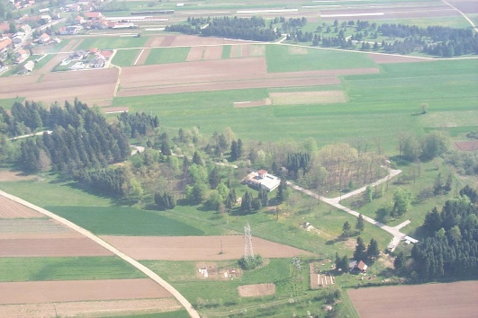
Slovenian pilot area AND WP1 ACTIVITIES description
ENHANCING WATER MANAGEMENT FOR CLIMATE CHANGE RESILIENCE IN ADRIATIC-IONIAN AREA
The Municipality of Ljubljana relies on two important aquifers for its drinking water supply: Ljubljansko polje and Ljubljansko barje. Ljubljansko polje is an unconfined intergranular aquifer, that is recharged by rainfall, the Sava River, and groundwater inflow. The Sava River plays a crucial hydrodynamic role, as it significantly recharging the aquifer. Ljubljansko polje is definitely an urban aquifer, but the prevailing land use is agricultural (43%). Urban areas have spread from the city centre along the main roads towards the boarders of the aquifer and cover 41% of the area. The quantitative and qualitative state of groundwater reflects land use and the increase in impermeable surfaces.
The Ljubljansko barje aquifer is located in the central part of Slovenia. The Brest well field is located on the Iška fan, where the gravel sediments of the Iška River and the lake sediments intersect. The area lies in the Ljubljansko barje Nature Park, in the Natura 2000 area and in drinking water protection zones. Arable land and settlements with infrastructure are the predominant land use. Due to the steep slopes in the upper part of Iška catchment area, surface runoff is immediate, especially in autumn and winter, when flooding is frequent.
Press contacts
Co-funding statement
This project is co-funded by the European Union under the Interreg IPA ADRION programme.
Disclaimer
The content of this press release is the sole responsibility of the author and can under no circumstances be regarded as reflecting the position of the European Union and/or IPA ADRION programme authorities
IMAGE
Brest well field flooding in 2010.
Hrastje well field in Ljubljansko polje.
https://aqua.interreg-ipa-adrion.eu/

